Slide 1
Using Apps During APE Direct Services
Heather Katz

Slide 2
Adapt with Apps
Ipad technology can help students with disabilities who have trouble with expressive language, social cues, sensory information, and verbal interaction (Roth, 2013).
When searching for apps to use in physical education, you can find useful programs in the App Store by searching for the following:
-Sign Language -Emotional Development
-Communication -Language Development
-Seeing and Hearing -Literacy and Learning
-Diagnostics & Reference -Organization
-Life Skills
(Roth, 2013)

Slide 3
Direct Service Uses
Ipads can also provide the following uses in direct service:
-Video Playback of Skills
-Warm up and Cool Down Activities
-Note Taking
-Music

Slide 4
My Apps
Super Stretch
-Provides an interactive stretching experience for the student. The student can choose from a series of characters. Each character has a story that goes along with it, and a demonstration of a stretch by a child.

Slide 5
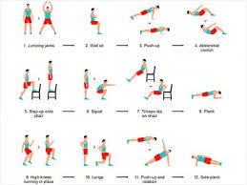
My Apps
7-Minute Workout
-Provides a structured workout with visuals that can be easily adapted for student needs. Allows the student pick music that has been downloaded to the Ipad to work out to.

Slide 6
How To Use Apps For Social Media Communication
Brittany Spann

Slide 7
Defining Social Media…
Social media or social networking sites are "web-based services that allow individuals to…
construct a public or semi-public profile within a bounded system,
(2) articulate a list of other users with whom they share a connection, and
(3) view and traverse their list of connections and those made by others within the system" (Boyd & Ellison, 2007, 211).
Social media allows individuals to connect with others publicly or privately on any topic of interest

Slide 8
Pinterest, a pin board style social photo sharing website.
On Pinterest you’re able to share strategies and activities to use with/for your students.
Also include APE tips, techniques, equipment, modifications, books, and so much more!
Twitter accounts share hints, tips, videos, and ideas on APE
Webquest, to post notes requiring students to complete a series of task using the internet.
There’s a blog site called #PECHAT.
This site provides readers with summaries of the chat, main ideas and opportunities to elaborate on chats dealing with APE or any general physical education class.
Apps That Are Used…

Slide 9
Teacher profiles, to upload videos of skills being performed and require that students view them and practice as a part of an assessment.
Teachers may post information about a specific sport or activity.
Teachers are able to inform parents/guardians/staff about sign up sheets.
Apps For Communicating…
Social media makes teachers more accessible, and also allows them to connect more easily with alumni and parents.

Slide 10
Using APPS for assessments/data collection
Brooke Mize

Slide 11
Literature Review
Availability of applications that can be used on demand from nearly any location makes APPS a 21st-century approach to health and physical activity
As the use of mobile technology in the classroom increases, teachers become more confident
Once the applications are known well, time saver for data collection
All assessments can be saved on the IPAD, making them easily transportable

Slide 12
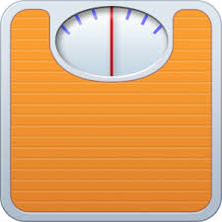
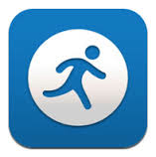
Assessment Tools & Data Collection
Lose it: allows individuals to track the number of calories consumed, share results with friends, plan meals, etc.
Mapmyrun: incorporate the app into the fitness unit during which students alternate working out in the weight room and jogging in neighborhoods surrounding the school.
EyeXam: tests for acuity, color perception, astigmatism, and eye dominance; includes tips for vision maintenance

Slide 13
Assessment Tools
“notes” app on their IPADS
Convert to PDFs is helpful to have all assessments handy when in need
Teachers can create content access post -session data and obtain daily activity reports.
I use notepad for data collection while working with my students.

Slide 14
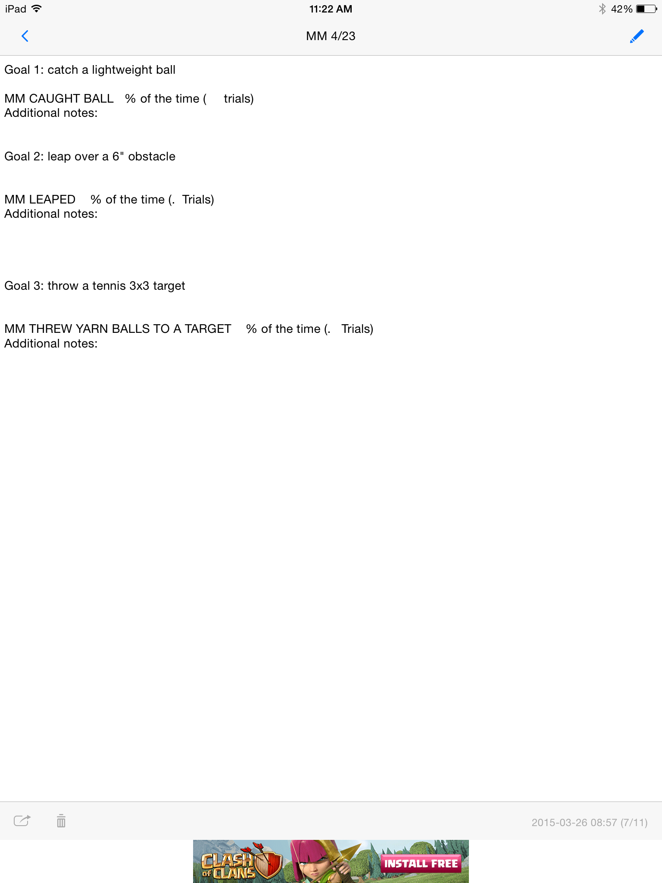
Data Collection

Slide 15
Using Apps in Group Teaching Settings
Mallory Beach

Slide 16
“The use of the Ipad is not the focal point of instruction, but rather used as an aid in learning.” “The use of the Ipad added a degree of seriousness and professionalism to the season.” (Sinelnikov, 2012)
Different Groups
Athletic setting
Behavioral setting
Classroom setting
Small group setting

Slide 17
Athletic Setting: Volleyball Unit
Team Role | Responsibility | Student Ipad Interaction | Teacher Role
Warm up leader | Lead Team warm-up activities | -Use the Video or YouTube app -Locate the daily warm up video | Restate key points of the task if necessary and Monitor the warm up and assist
Manager | Assist Teammates in learning officiating signals | -Use the iReferee app -Locate relevant sport and officiating signals within the app -View officiating signals | Monitor the accuracy of signal Clarify game situation of signals used
Awards Committee Member | Create a presentation for the ending event | -Use Keynote app -transfer photos to the Ipad -connect to projector and show class | Teach how to use app and help with connections

Slide 18
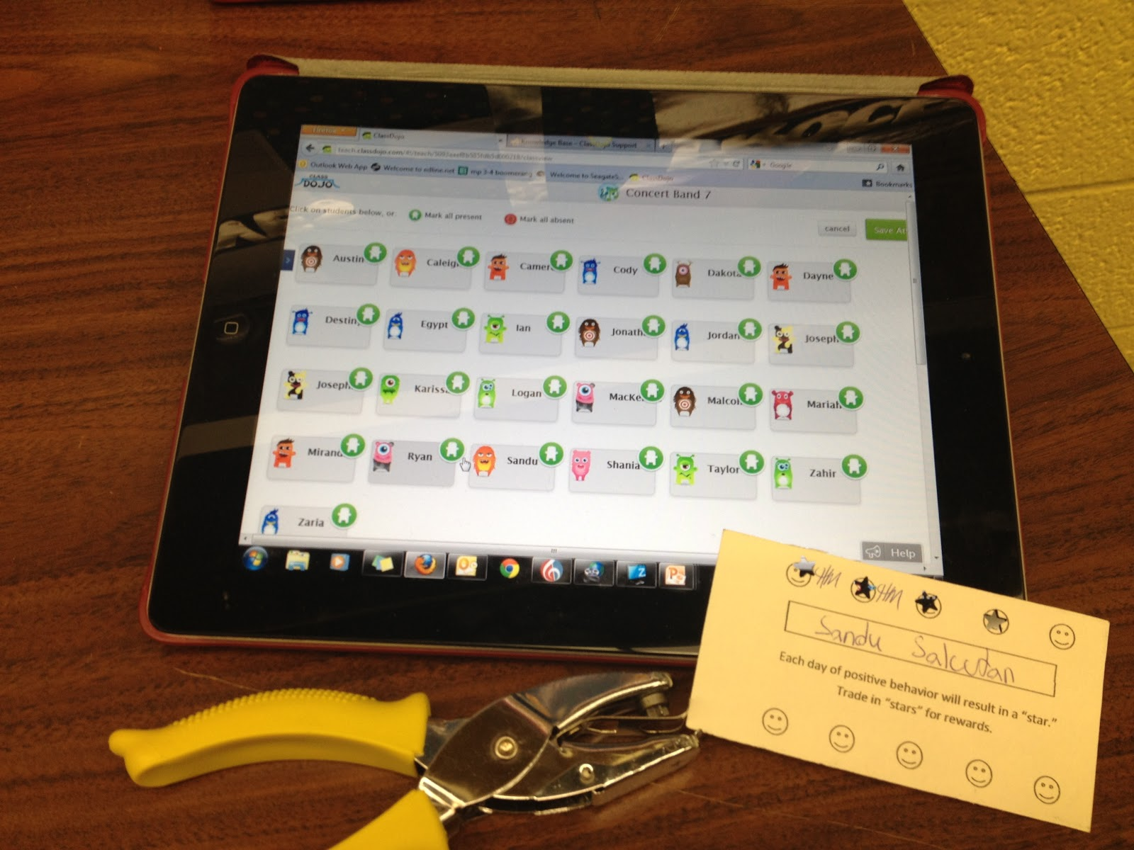
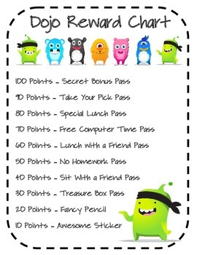
Class DOJO APP
Rewards positive behavior with DOJO points
Teacher can customize behaviors (helpful, on task, etc…) any award student when skill is demonstrated
Connects to parents and other teachers
Students can sign in and visually view their performance and self-reflect
Can be used on ANY device!

Slide 19
Works Cited
Cummiskey, M., & Leight, J. (n.d.). Social Media and ehysical Education. Promoting Active and Healthy Lifestyles. Retrieved from http://www.pelinks4u.org/articles/cummiskey&leight_2012.htm
Cummiskey, M. (2011). There’s an app for that Smartphone used in health and physical education. Journal of Physical Education, Recreation & Dance, 82, 8.
Google.com/images
Roth, K. (2013). Adapt with apps. Journal of Physical Education, Recreation & Dance, 84(2), 4-6.
Sinelnikov, O. (2012). Using the ipad in a sport education season. Journal of Physical Education, Recreation & Dance, 39-45.

